Slide 1
Sample file with explanation

Slide 2
B-Scan
B-scan, or "Brightness scan," is a method used in imaging techniques such as ultrasound, radar, GPR, and medical imaging.
It creates a two-dimensional cross-sectional image of a scanned object or area.
The B-scan provides detailed information about the depth and position of objects within the scanned area, making it a powerful tool for various fields.

Slide 3
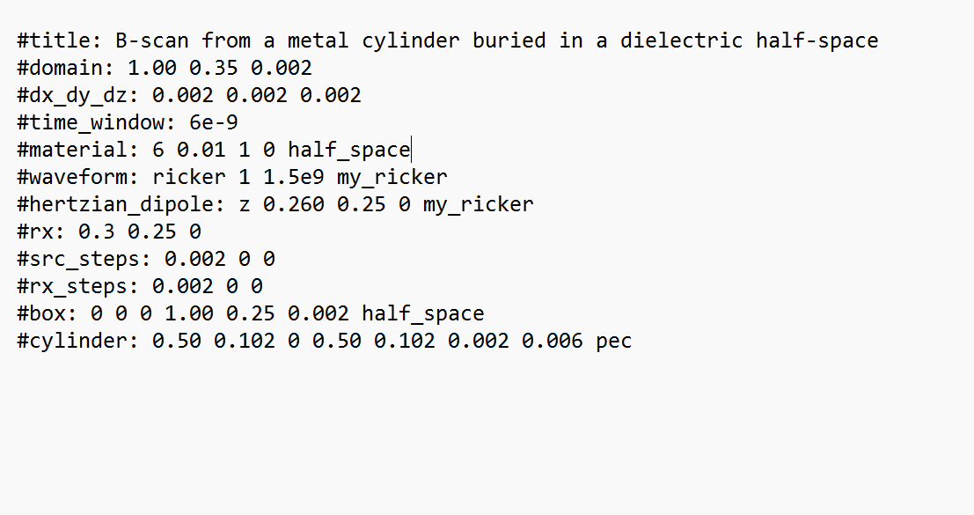
B-scan Example
Title : B-scan from a Metal Cylinder Buried in a Dielectric Half-Space
B-scan produces a 2D cross-sectional image.
Focus on detecting a metal cylinder buried in a dielectric half-space.

Slide 4
Domain Definition
*x-axis: 1.00 meters
*y-axis: 0.35 meters
*z-axis: 0.002 meters
*The small z-axis value suggests a 2D simulation with fine discretization.
Grid Resolution
*x-axis: 0.002 meters (2 mm)
*y-axis: 0.002 meters (2 mm)
*z-axis: 0.002 meters (2 mm)
*Grid Spacing (dx, dy, dz) defines the smallest feature size the simulation can resolve.

Slide 5
Time Window:
*Duration: 6 nanoseconds.
*Determines the simulation's total run time.
*Affects penetration depth and response recording.
Material Properties:
*Represents the ground or dielectric material.
*Relative Permittivity (εr): 6
*Conductivity (σ): 0.01 S/m
*Magnetic Permeability (μr): 1 (relative to free space)
*Magnetic Loss: 0
*Material Name: half_space

Slide 6
Waveform Configuration:
*Common in GPR simulations for its similarity to real radar pulses.
*Type: Ricker Wavelet
*Amplitude: 1
*Frequency: 1.5 GHz
*Name: my_ricker
Hertzian Dipole:
*Orientation: z-axis
*Coordinates: (0.260, 0.25, 0)
*Waveform: my_ricker
*Acts as the source of the electromagnetic wave.

Slide 7
Receiver Location
* Records the reflected signal from the subsurface.
*Coordinates: (0.3, 0.25, 0)
Source Steps (src_steps):
*x-axis: 0.002 meters
*y-axis: 0 meters
*z-axis: 0 meters
Receiver Steps (rx_steps):
*x-axis: 0.002 meters
*y-axis: 0 meters
*z-axis: 0 meters
*Both source and receiver move along the x-axis to scan the subsurface.

Slide 8
Box Definition:
*Starting Coordinates: (0, 0, 0)
*Dimensions: 1.00 x 0.25 x 0.002 meters
*Material: half_space
*Defines the region representing the dielectric half-space.
Cylinder Definition:
*Starting Coordinates: (0.50, 0.102, 0)
*Ending Coordinates: (0.50, 0.102, 0.002)
*Radius: 0.006 meters
*Material: Perfect Electric Conductor (PEC)
*Purpose: Represents the buried metal cylinder.

Slide 9
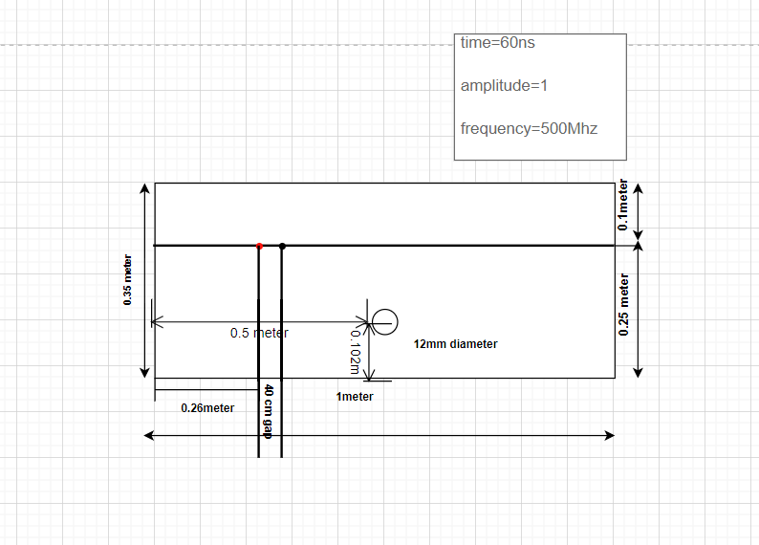
Geometric View
Frequency=1.5GHz

Slide 10
Steps to create geometric view.
The domain is 1 meter by 0.35 meters by 0.002 meters.
The domain will be a rectangle with 1 m wide, 0.35 m tall.
The source is positioned at (0.260, 0.25, 0) in the domain.
This position is 26 cm from the left edge and 25 cm from the bottom.
The receiver is positioned at (0.3, 0.25, 0).

Slide 11
Steps to create geometric view.
This is 30 cm from the left edge and 25 cm from the bottom.
The cylinder is located at (0.50, 0.102, 0) with a length along the z-axis (0.50, 0.102, 0.002) and a radius of 0.006 meters (6 mm).
The cylinder's centre is 50 cm from the left edge and 10.2 cm from the bottom.
The grid spacing is 0.002 meters (2 mm) in each direction, which indicates a high-resolution setup.

Slide 12
Steps to create geometric view.
The box covers the entire domain with dimensions (0, 0, 0) to (1.00, 0.25, 0.002).
This box represents the dielectric half-space in which the cylinder is buried.
Time Window: 6 nanoseconds, Frequency: 1.5 GHz , Amplitude: 1.

Slide 13
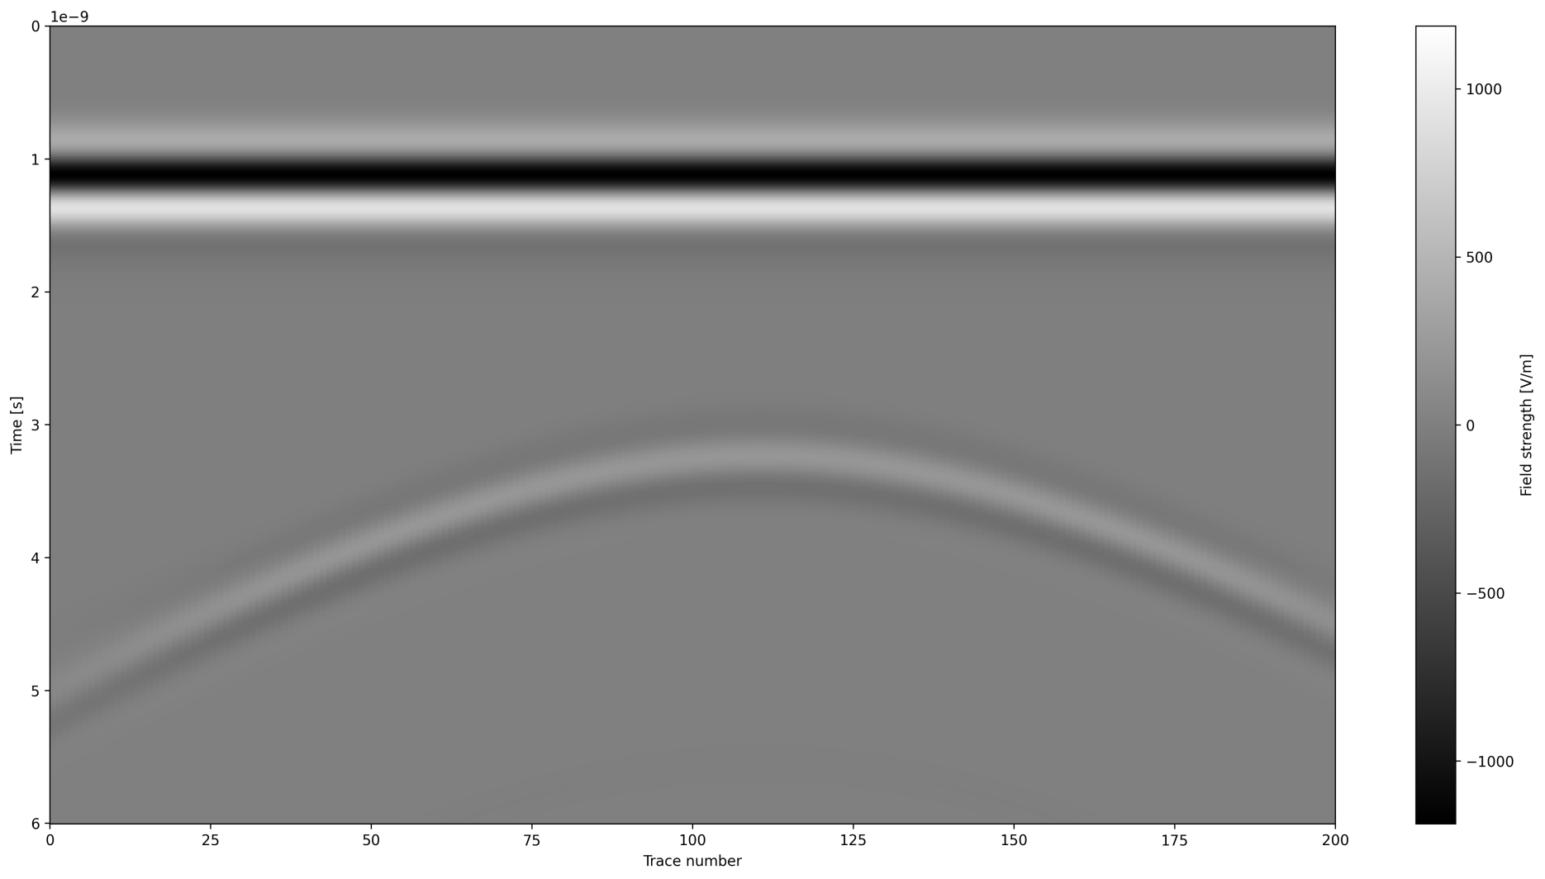
B-scan Image(12mm diameter 148mm depth)

